Slide 1
Modern SharePoint Site Designs and Scripts
Bob German Partner Technical Architect Microsoft
Notes:
Site Designs are the site templates of modern SharePoint. The enterprise can publish a number of designs which can be chosen when a new SharePoint site is created. Each new site is ready to go with custom list and views, branding elements, pages and web parts, and is automatically enrolled in hub relationships to manage navigation. In this session you'll learn how to develop your own Site Designs and Site Scripts, and how to connect them with Microsoft Flow and OfficeDev PnP PowerShell. You'll also learn how to configure Site Designs and target them to particular users as a part of governance. Join in and start taking advantage of modern SharePoint provisioning!

Slide 2

Agenda
Modern SharePoint
Classic approaches to site provisioning
Site Designs and Scripts
Adding PnP provisioning to your site script
Applying Site Scripts

Slide 3
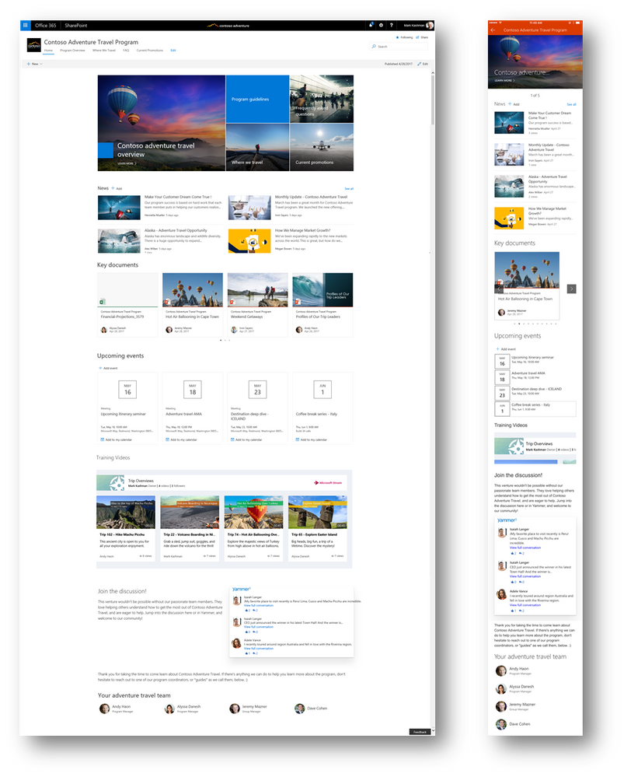
What is Modern SharePoint?
Updated, mobile friendly user experience
SP Online and SP 2019 only
Client-side rendering – faster, especially across geographies
Easier editing
Works in top-level sites only, no child site support
Use Hub Sites for flexible organization
What is modern SharePoint and why should I care? http://bit.ly/SPModern

Slide 4
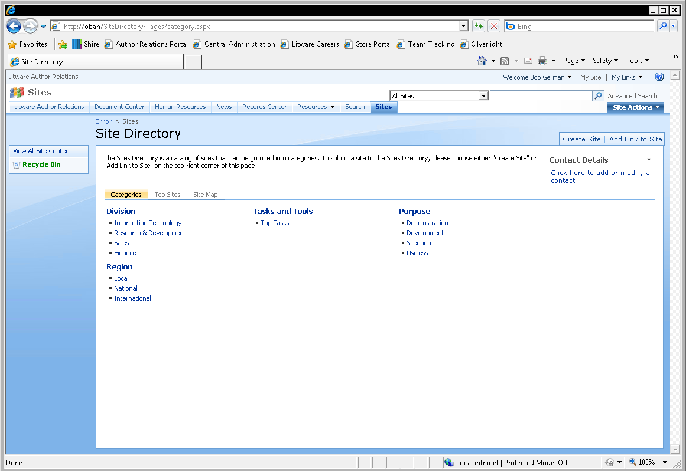

Self-Service Site Provisioning
Version | Where → What | Customize using
SP2003, SP2007 | Site Directory → Child site | Site Definitions Web Templates
@Bob1German

Slide 5
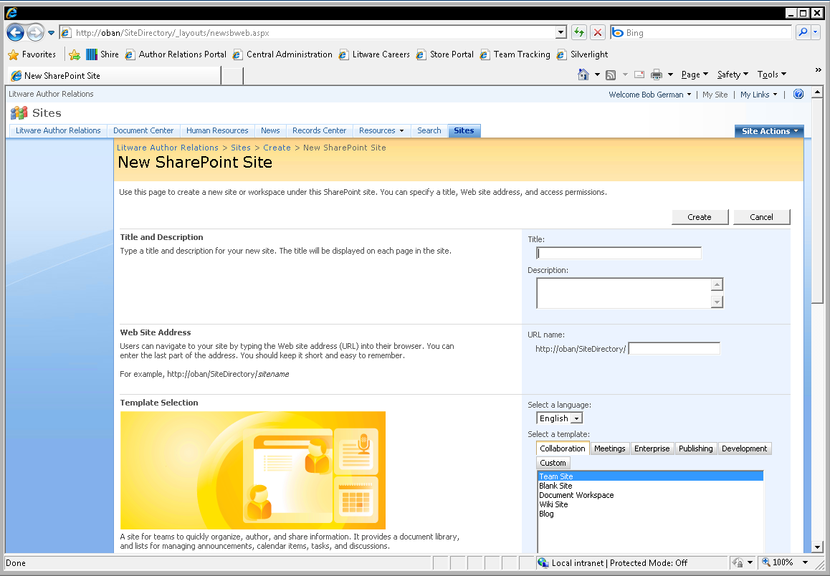
Self-Service Site Provisioning
Version | Where → What | Customize using
SP2003, SP2007 | Site Directory → Child site | Site Definitions Web Templates
@Bob1German

Slide 6
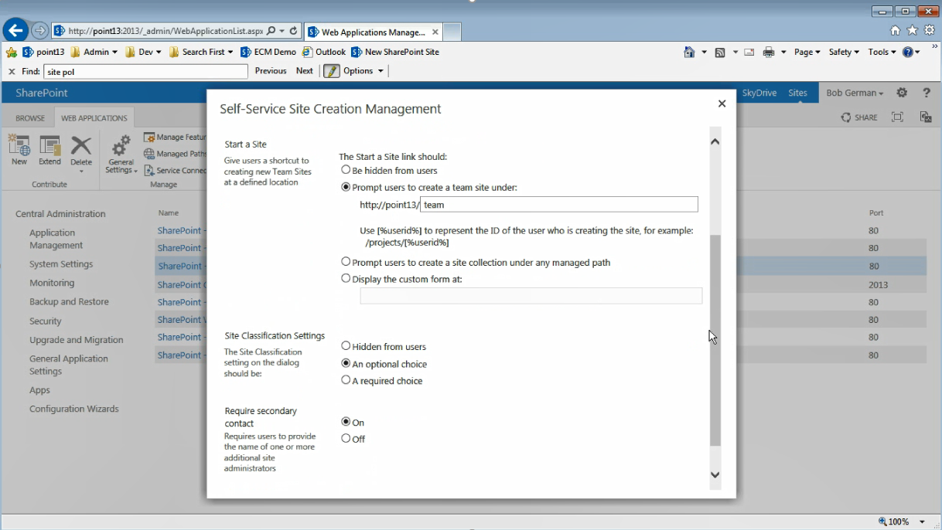
Self-Service Site Provisioning
Version | Where → What | Customize using
SP2003, SP2007 | Site Directory → Child site | Site Definitions Web Templates
SP2010, SP2013, SP2016 | Sites tab in personal site → Site collection OR Child site | Site definitions Web Templates
@Bob1German

Slide 7
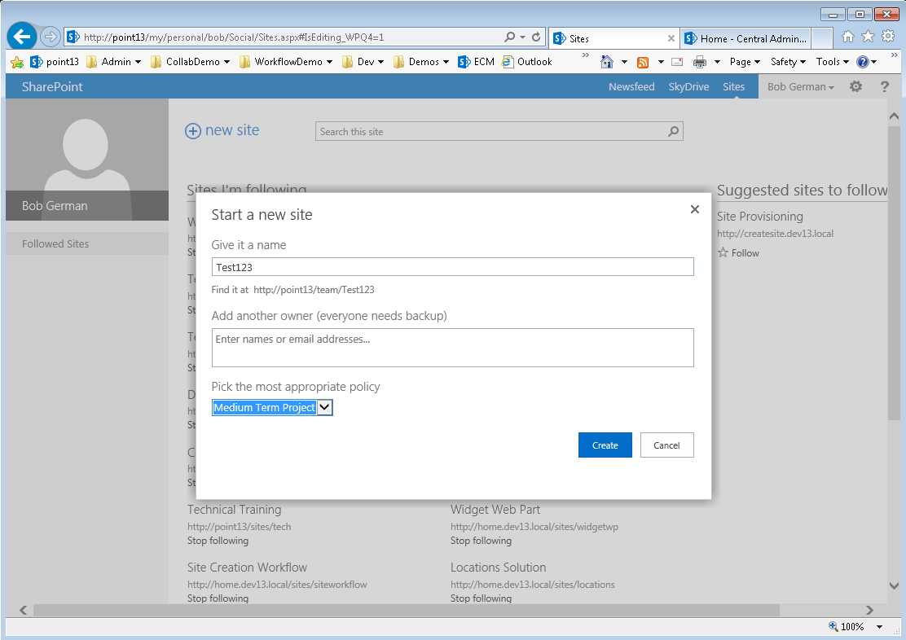
Self-Service Site Provisioning
Version | Where → What | Customize using
SP2003, SP2007 | Site Directory → Child site | Site Definitions Web Templates
SP2010, SP2013, SP2016 | Sites tab in personal site → Site collection OR Child site | Site definitions Web Templates
@Bob1German

Slide 8
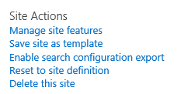
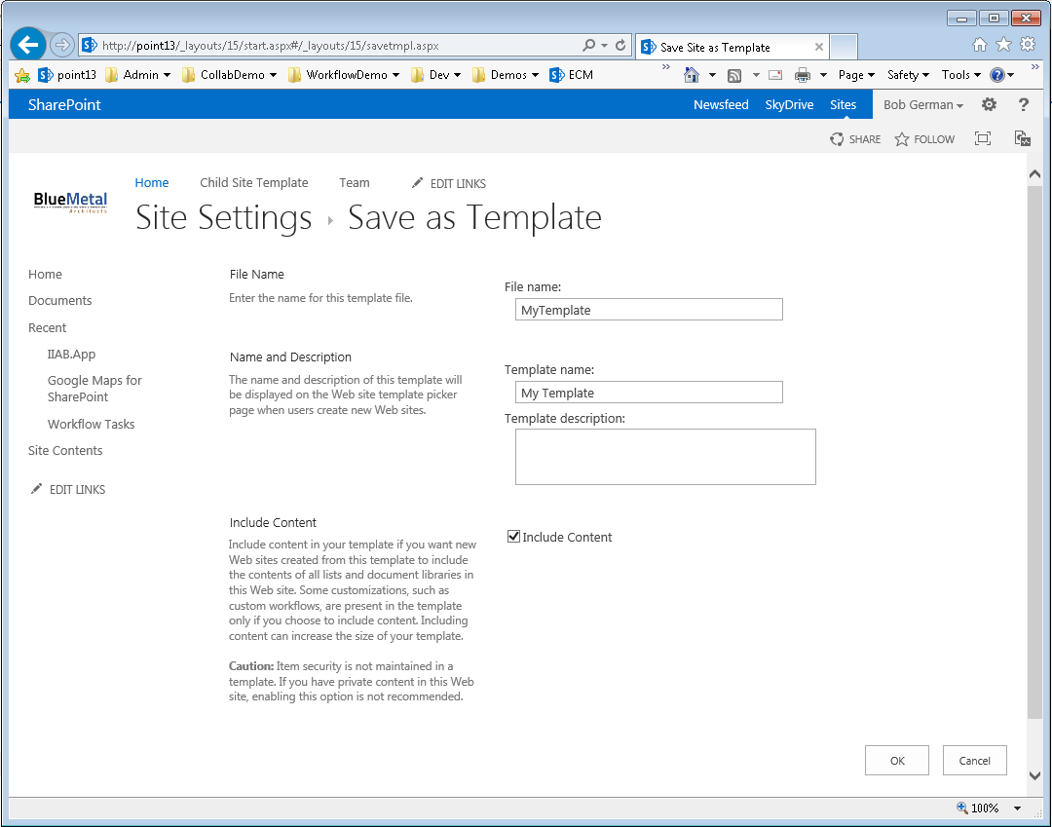
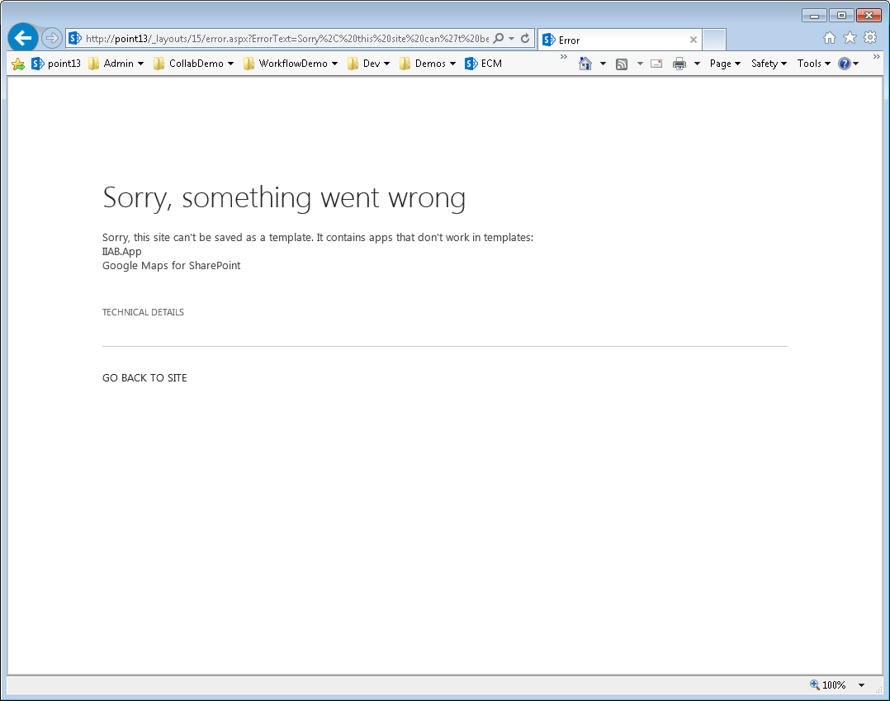
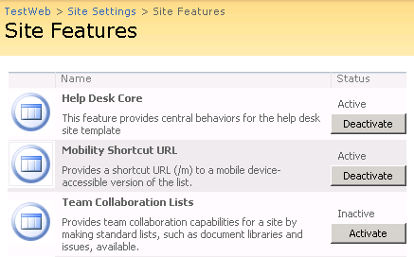
The problem with Web Templates and Features
Problems
Deactivation leads to orphaned web parts, lists, etc.
Content breaks if the solution that created it is no longer present
Difficult to version and update
Features at the Site or Web level have to be updated in each site or web
Difficult to debug; generally arcane
@Bob1German

Slide 9

Remote Provisioning Pattern
It’s simple…
Just create SharePoint content using any remote API (CSOM, JSOM, SOAP, REST)
.NET Code in PowerShell or a console application
Run manually
Run from an Azure WebJob or Windows Scheduled Task
Javascript in a SharePoint Hosted App or Content Editor Web Part
.NET Code in a Provider Hosted App
The Mechanical Turk approach (A person manually creates content using a web browser)
Instead of building your solution within SharePoint, deploy each part from outside SharePoint, like building a ship in a bottle.
@Bob1German
@Bob1German
Notes:
Image licensed under creative commons - https://upload.wikimedia.org/wikipedia/commons/3/37/Nelson's_Ship_in_a_Bottle_2.jpg

Slide 10

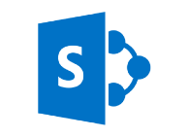

Office Developer Patterns and Practices
YOUR CODE HERE
PowerShell Commands
Remote Timer Job Framework
Widget Wrangler
https://github.com/OfficeDev/PnP
Core Library
There is much more in the OfficeDev PnP library; this picture shows the components that will be discussed in this session.
CSOM “15”
CSOM “16”
SharePoint 2013
SharePoint 2016 and Online
Site Provisioning with PnP PowerShell

Slide 11
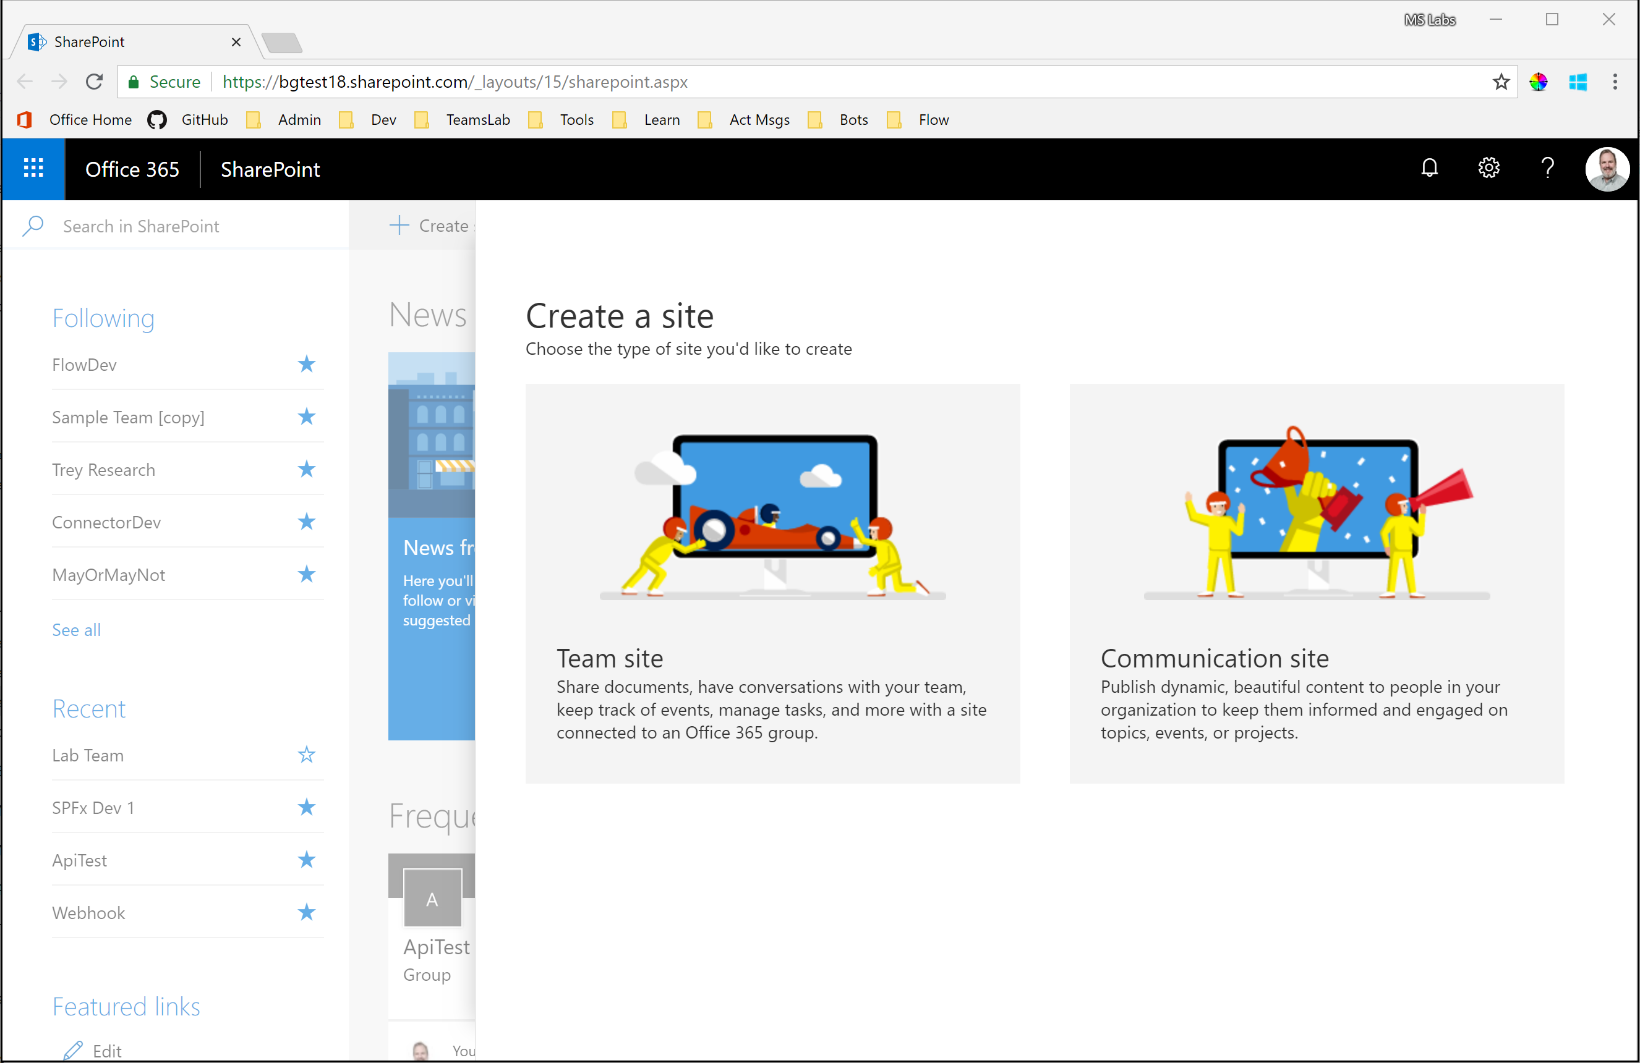
Self-Service Site Provisioning
Version | Where → What | Customize using
SP2003, SP2007 | Site Directory → Child site | Site Definitions Web Templates
SP2010, SP2013, SP2016 | Sites tab in personal site → Site collection OR Child site | Site definitions Web Templates
SP Online | SharePoint Home → Site Collection | Site Designs and Scripts
Site Provisioning with Site Designs and Scripts

Slide 12
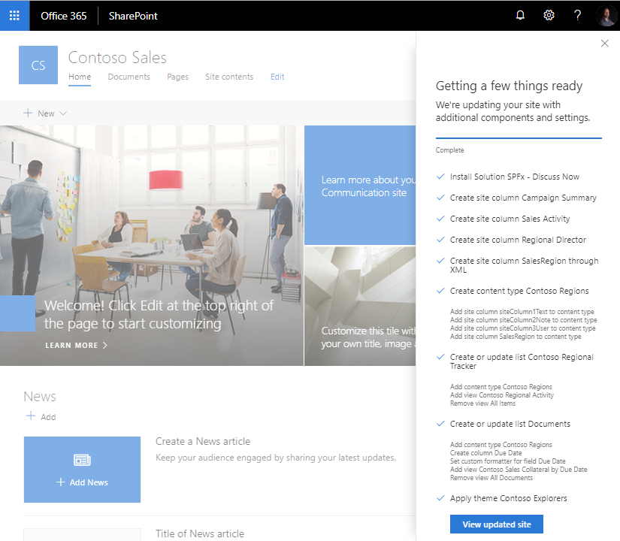
Site designs: modern templating model
A new approach for extending modern templates post-creation to automate the custom configuration of sites.
A new script model to apply custom “actions” to a site after creation.
Can be injected into the self-service site provisioning flow or manually applied to existing sites – and soon: when joining a hub!
This approach is inspired by the “remote provisioning” pattern we’ve espoused through PnP

Slide 13
When to use site designs
Application of specific configurations or business logic consistently when new sites are created
Updating existing sites with common site elements
Amending OOB templates w/ select customizations
Configuring sites associated to a hub
Legal SD
Site Instances
Project SD
Site Instances
Team (64)
Site Instances
IT@Contoso Hub
Site Instances

Slide 14
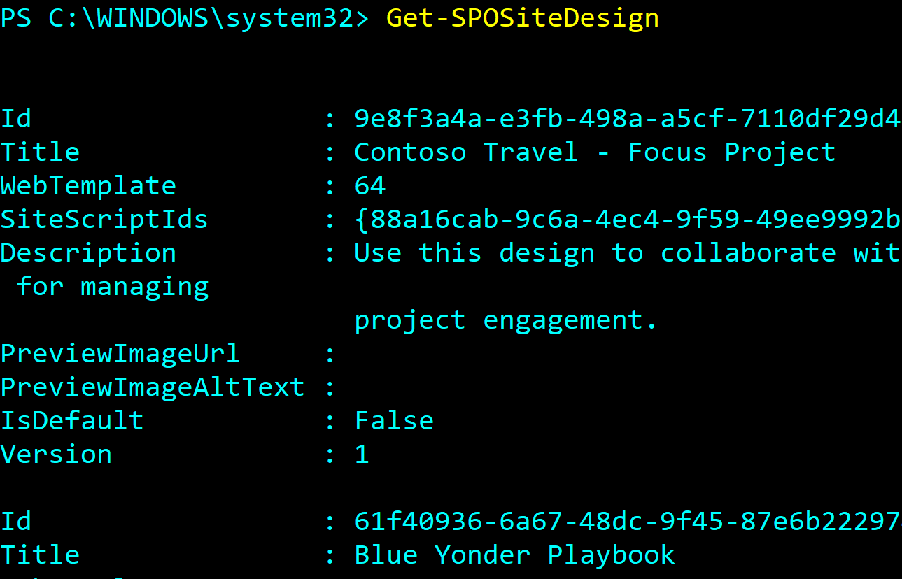
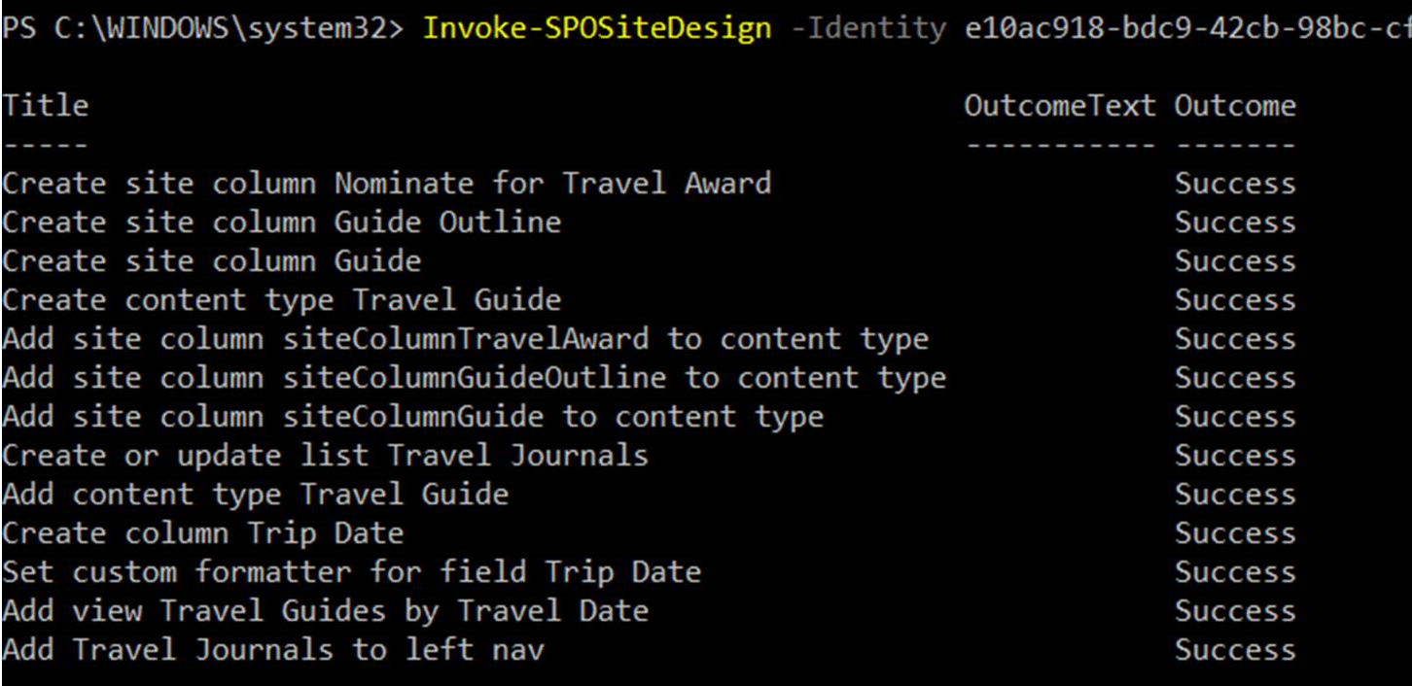
Site Design CRUD
Use PowerShell & REST to create and manage site designs and site scripts
Associating scripts to designs
Scoping visibility in self-service site
creation
Applying to a default template
Applying to an existing site
PowerShell: https://docs.microsoft.com/en-us/sharepoint/dev/declarative-customization/site-design-powershell
REST: https://docs.microsoft.com/en-us/sharepoint/dev/declarative-customization/site-design-rest-api

Slide 15
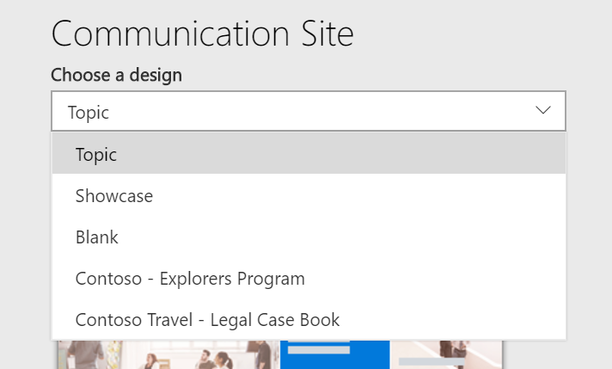
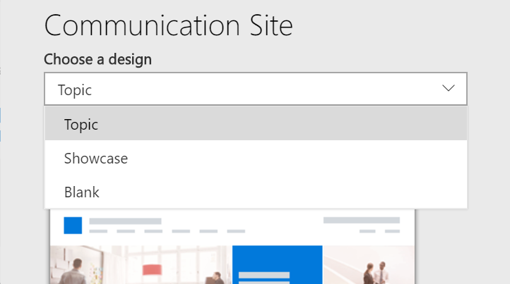
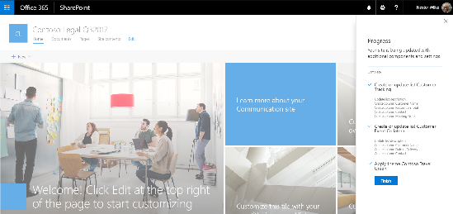
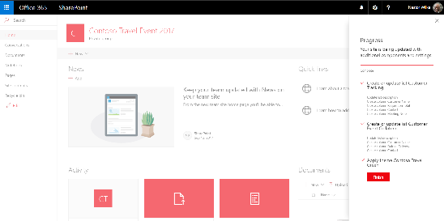
Site designs in site creation flow
Site design selections appear in site provisioning UX (per base template)
1
3
2
Site Scripts - Actions
Execute Site Design
Create List
Apply Theme
Add to Nav
Trigger Flow
Join a hub site
After site creation script actions are initialized and processed – as each are run, they are saved to a local list and rendered in progress panel
During site creation we create a parameter in site property bag – this is used by site design feature to apply site scripts.

Slide 16
Anatomy of site designs & site scripts
"$schema": "schema.json",
actions: [
...
{
"verb": "createSPList",
"listName": "Contoso Project Tracker",
"templateType": 100,
"subactions":
[
{
"verb": "SetDescription",
"description": "Custom list to illustrate SharePoint site scripting capabilities"
},
{
"verb": "addContentType",
"name": "Contoso Projects"
},
{
"verb": "addSPFieldXml",
"schemaXml": "<Field Type=\"Choice\" DisplayName=\"Project Status\" Required=\"FALSE\" Format=\"Dropdown\" StaticName=\"ProjectStatus\" Name=\"ProjectStatus\"><Default>In progress</Default><CHOICES><CHOICE>In progress</CHOICE><CHOICE>In review</CHOICE><CHOICE>Has issues</CHOICE><CHOICE>Done</CHOICE></CHOICES></Field>"
},
{
"verb": "addSPView",
"name": "Contoso Projects by Status",
"viewFields":
...
Site Script: JSON file of actions to be applied to the site post-creation
Limits (as of May 2018)
100 site scripts and site designs
30 cumulative actions and/or 30K character limit / site design
Actions can be concatenated in single file or multiple files can be used (and reused)
Site Design attributes designate display characteristics and target template
Add-SPOSiteDesign
-Title <string>
-WebTemplate <string>
-SiteScripts <SPOSiteScriptPipeBind[]>
[-Description <string>]
[-PreviewImageUrl <string>]
[-PreviewImageAltText <string>]
[-IsDefault]

Slide 17



Available Site Script Actions right now
Site Settings
SharePoint Components
Apps & Solutions
addPrincipalToSPGroup
addNavLink
applyTheme
setSiteLogo
setRegionalSettings
setSiteExternalSharingCapability
triggerFlow
joinHubSite
createSPList
addSPField
deleteSPField
addSPFieldXml
createSiteColumn
createSiteColumnXml
addSiteColumn
addContentType
createContentType
removeContentType
addSPView
removeSPView
setSPFieldCustomFormatter
installSolution
SPFx Extension support!
associateExtension
associateListViewCommandSet
associateFieldCustomizer
JSON Schema: https://docs.microsoft.com/en-us/sharepoint/dev/declarative-customization/site-design-json-schema

Slide 18

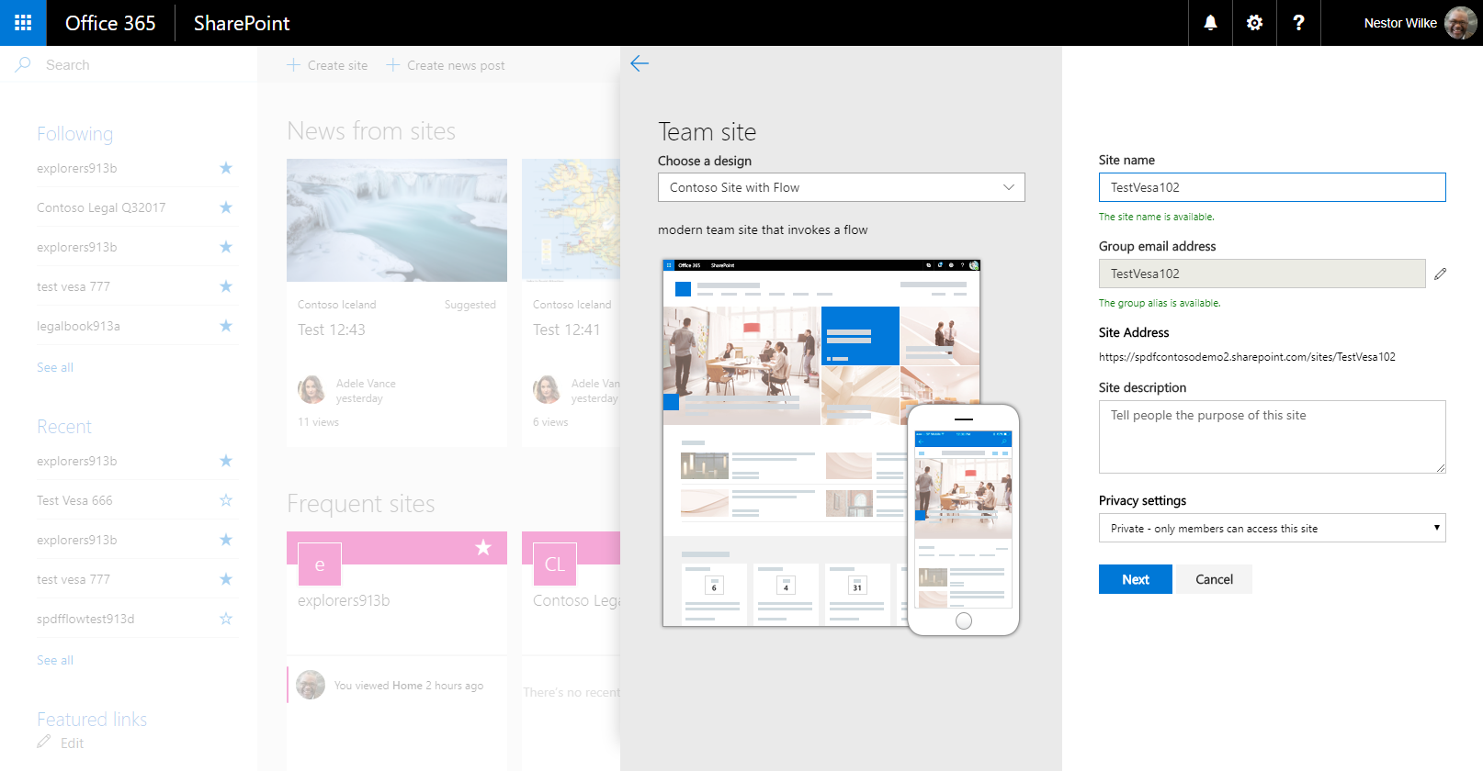
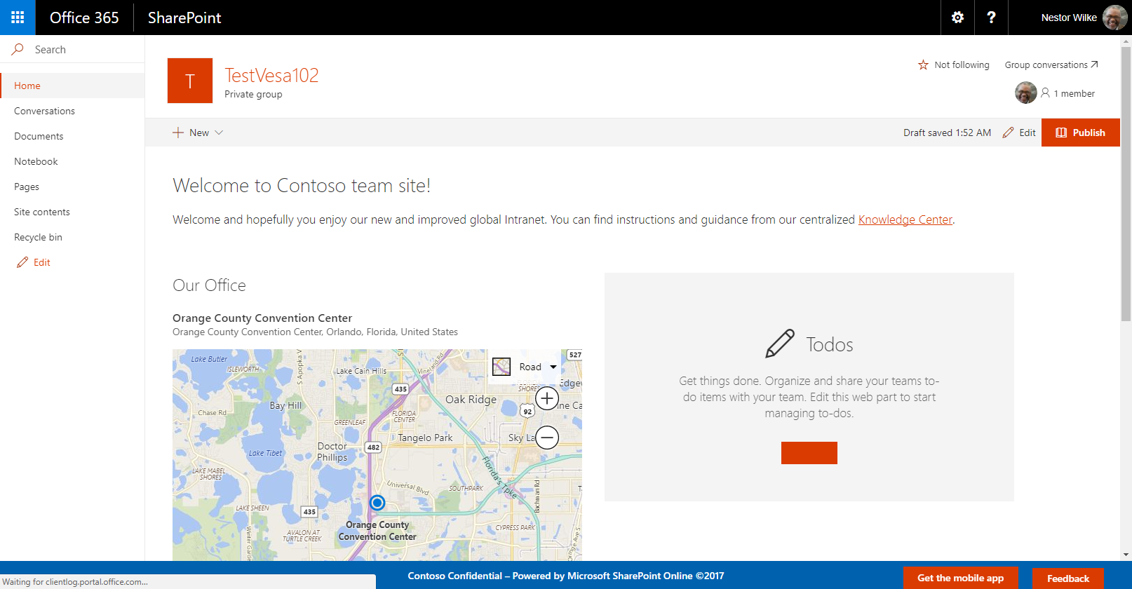

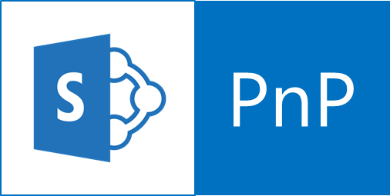
Site Scripts with app integration How to integrate custom logic into out-of-box provisioning flow
Script initiates previously configured flow, using the newly created site URL as parameter. Flow includes a step to pass site URL to Azure storage queue for delegating processing to Azure side.
var flowScript = {
"$schema": "schema.json",
"actions": [{
"primary_verb": "Flow.Trigger",
"target": “<<http post url>>",
"name": “contoso hr additions",
"parameters": {
"department": "HR",
"cost center": "1023"
}
}
],
"bindata": {},
"version": 1
};
Microsoft Flow
triggerFlow script action
Site URL
Site Description
Created By
Creator Email
UTC Creation Time
SharePoint Online
<<instantiate with site details>>
1
<<add message >>
2
Storage Queue
Azure Function
<<apply configurations>>
<<instantiate>>
4
3
Site URL is used as a parameter to connect to site using remote APIs. Customizations applied using remote provisioning techniques, for example with PnP remote provisioning template model.
Code Walk-through

Slide 19
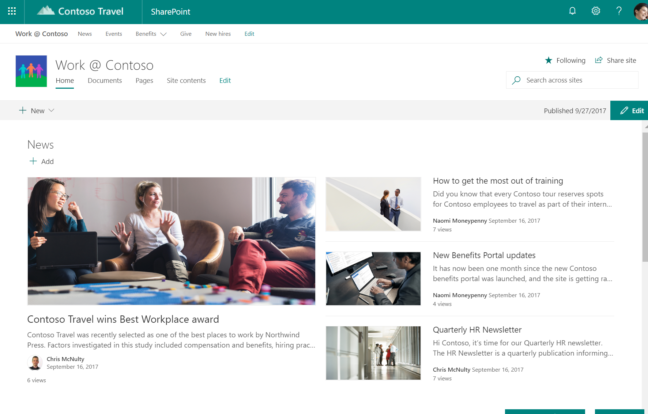
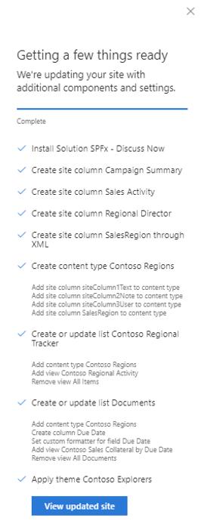
Site Designs for Hubs!
Site designs will become an optional configuration capability - connected to a hub and then applied to sites on join.
These designs are published globally and can be used on one or more hubs.
The scripts are executed on join; additive so nothing is lost on site moves

Slide 20
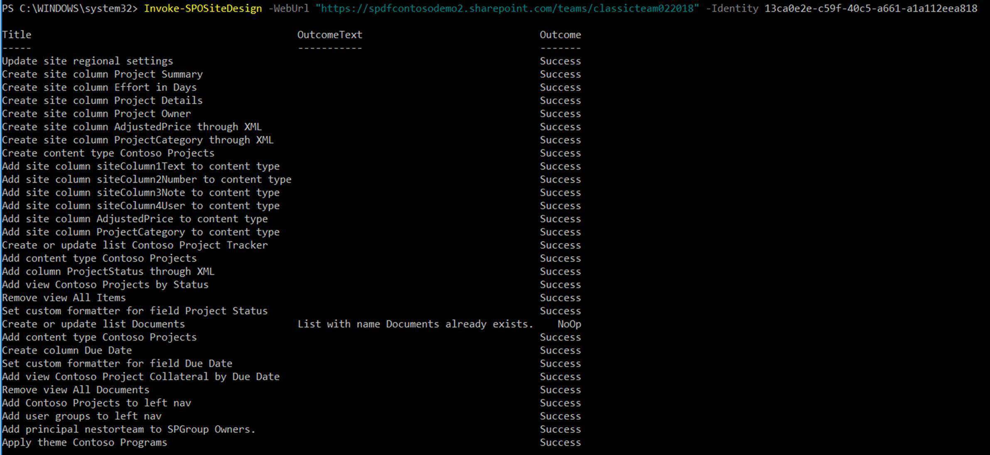
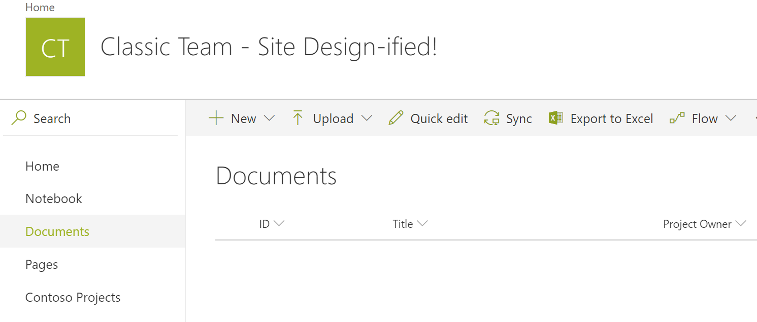
Site Designs for Existing Sites!
Site designs can also be applied to existing sites.
PowerShell or REST can be used to apply a published design to a site.
Currently we only support modern site templates, but application to additional site templates coming soon!

Slide 21
Site Scripts & Site Designs
Official Documentation
https://aka.ms/spsitedesigns
https://docs.microsoft.com/en-us/sharepoint/dev/declarative-customization/site-design-overview
Open-Source Site Script Samples
http://aka.ms/spsitescriptsamples
https://github.com/SharePoint/sp-dev-site-scripts
Recent Announcements:
https://techcommunity.microsoft.com/t5/SharePoint-Blog/SharePoint-Site-Scripts-and-Site-Designs-April-2018-release/ba-p/181254

Slide 22
UserVoice – SharePoint Dev
Make yourself heard! Help us prioritize!
http://aka.ms/spdev-uservoice
https://aka.ms/spsitedesignuservoice
SharePoint Tech Community
https://techcommunity.microsoft.com

Slide 23
Thank you!

